Slide 1

Hadoop

Slide 2


Map-Reduce
MAP Reduce:
It is a kind of concept in the big data processing or parallel computing.
It has two phases:
Map phase.
Reduce Phase.
Map phase: Read blocks of data and generate output in the form of key-value pair.
Reduce Phase: Reads key-value generated by the Mapper and aggregate the results. Final result will also be in key-value format.

Slide 3
Map-Reduce
MAP Reduce:

Slide 4
Map-Reduce
MAP Reduce Execution Flow:
In the parallel computation, we send our code to the cluster

Slide 5
Map-Reduce
MAP Reduce Execution Flow:

Slide 6
Map-Reduce
How many mapper task will be created?
It is equivalent to the number of blocks of data.
Note: The number of blocks are only the original ones not the replicated ones.
If we have a huge amount of data and we want to achieve better performance. So, we must put the optimized number of reducer to load the balance properly.
If we have 1 reducer then the job takes too much time.
To choose the optimized number of reducer, various parameters are required to consider.

Slide 7
Map-Reduce
To choose the optimized number of reducer, various parameters are required to consider.
Amount of data get process.
Machine specification
Bandwidth.
Hadoop / Map-reduce will smartly choose the right number of reducer for a particular job.

Slide 8
Map-Reduce
Simply the file or reference for the data that is stored in HDFS.
In big data, some kind of compressed file format are very popular e.g., CSV, JSON, AVRO, Parquet and ORC.
We need to define the format in which data is stored in HDFS.
Define how these input files are read from the source.
How to serialize and desearlize them properly

Slide 9
Map-Reduce
Logical representation of the data, which will be processed by an individual mapper task.
One mapper task is created for each input split.
It is equivalent to the number of blocks.
It is like a reference to the original block of data.

Slide 10
Map-Reduce
It communicates with the input split
Logical reference for the physical data stored in blocks in HDFS.
Converts the data into key-value pairs.

Slide 11
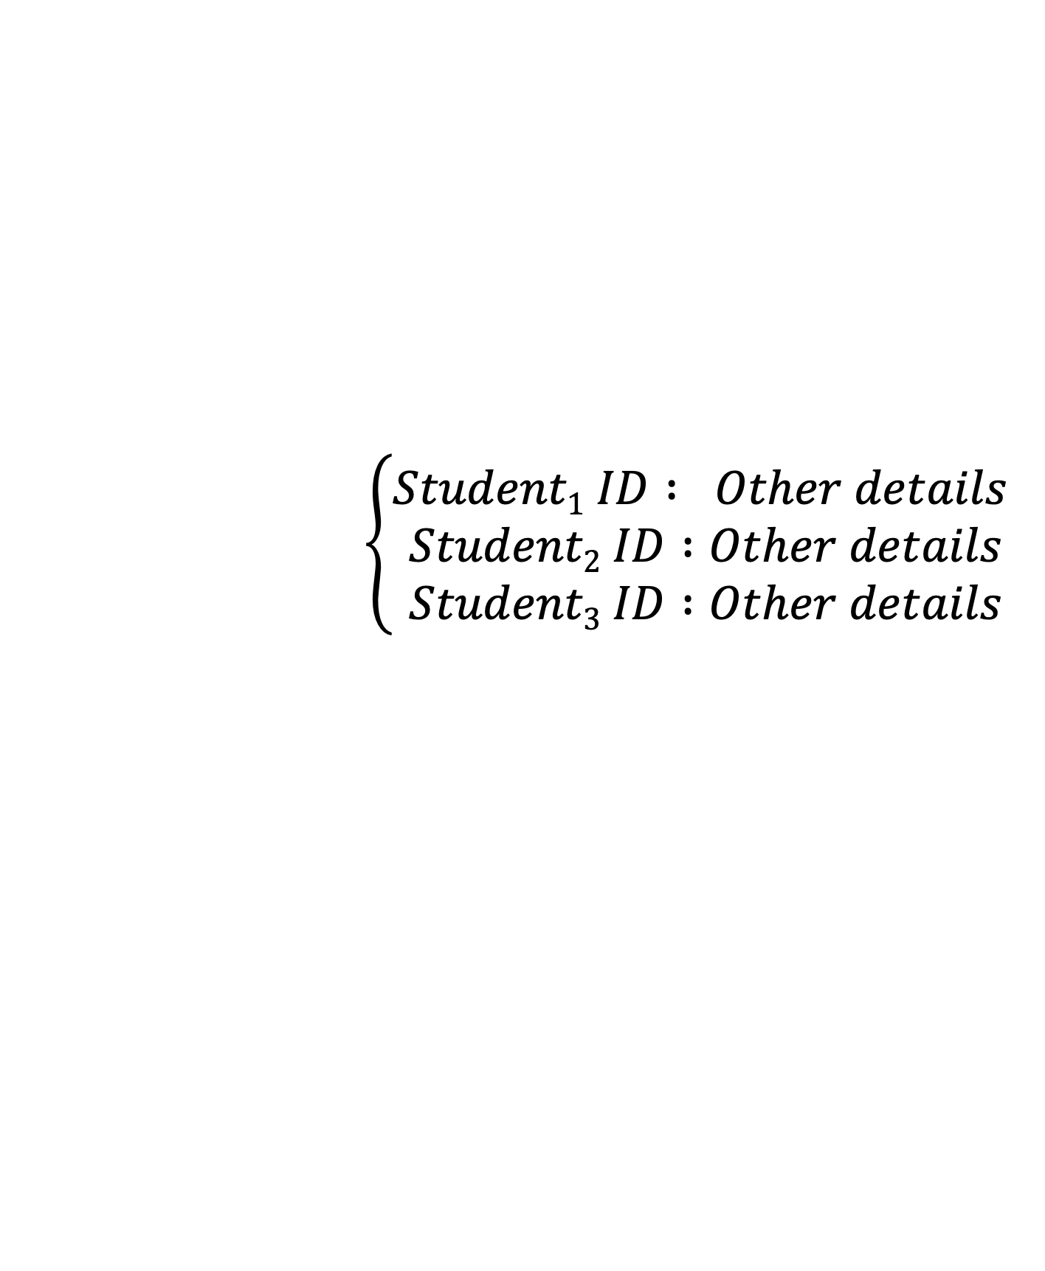
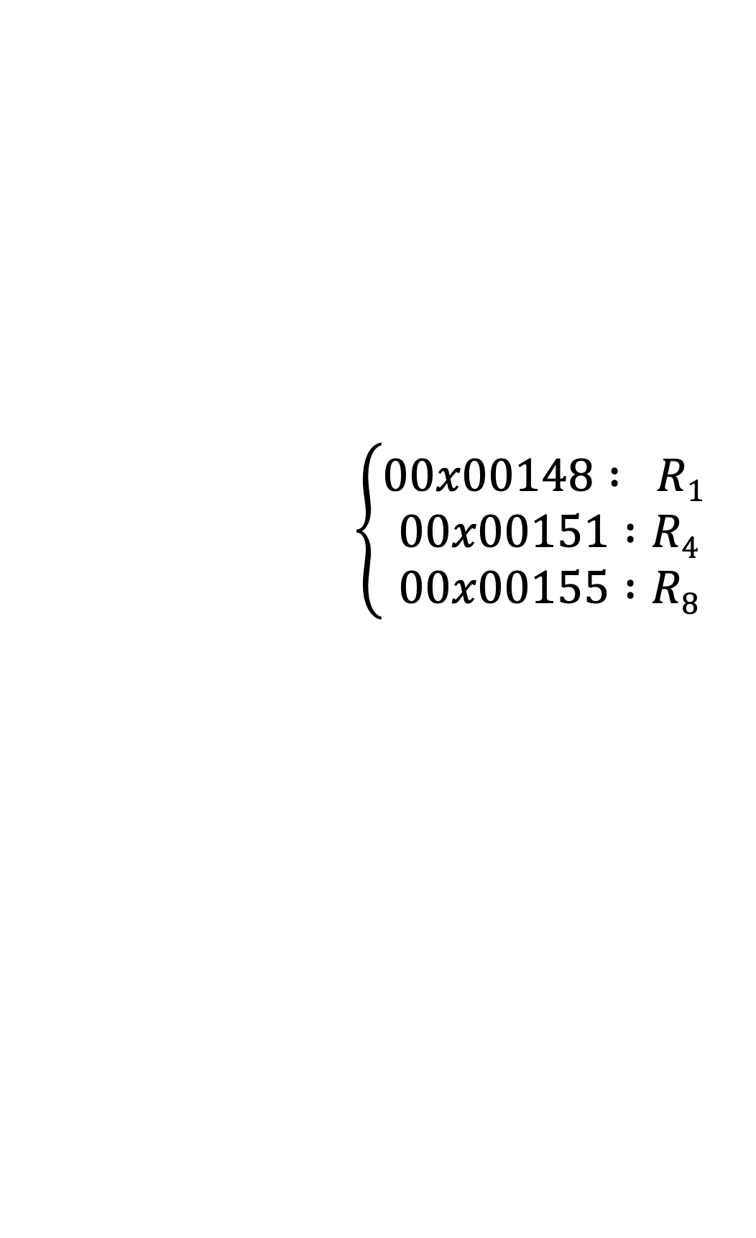
Map-Reduce
It process each input record from record reader and generates a new key-value pair, which is different from input key-value pair.
$$\left\{\begin{aligned}00x00148 : R1 \\ 00x00151 :R4 \\ 00x00155 :R8\end{aligned}\right.$$
$$\left\{\begin{aligned}Student1 ID : Other details \\ Student2 ID :Other details \\ Student3 ID :Other details\end{aligned}\right.$$
Raw data

Slide 12
Map-Reduce
It is like a mini-reducer.
It locally aggregates the results generated by each mapper.
It will be better explained via an example

Slide 13
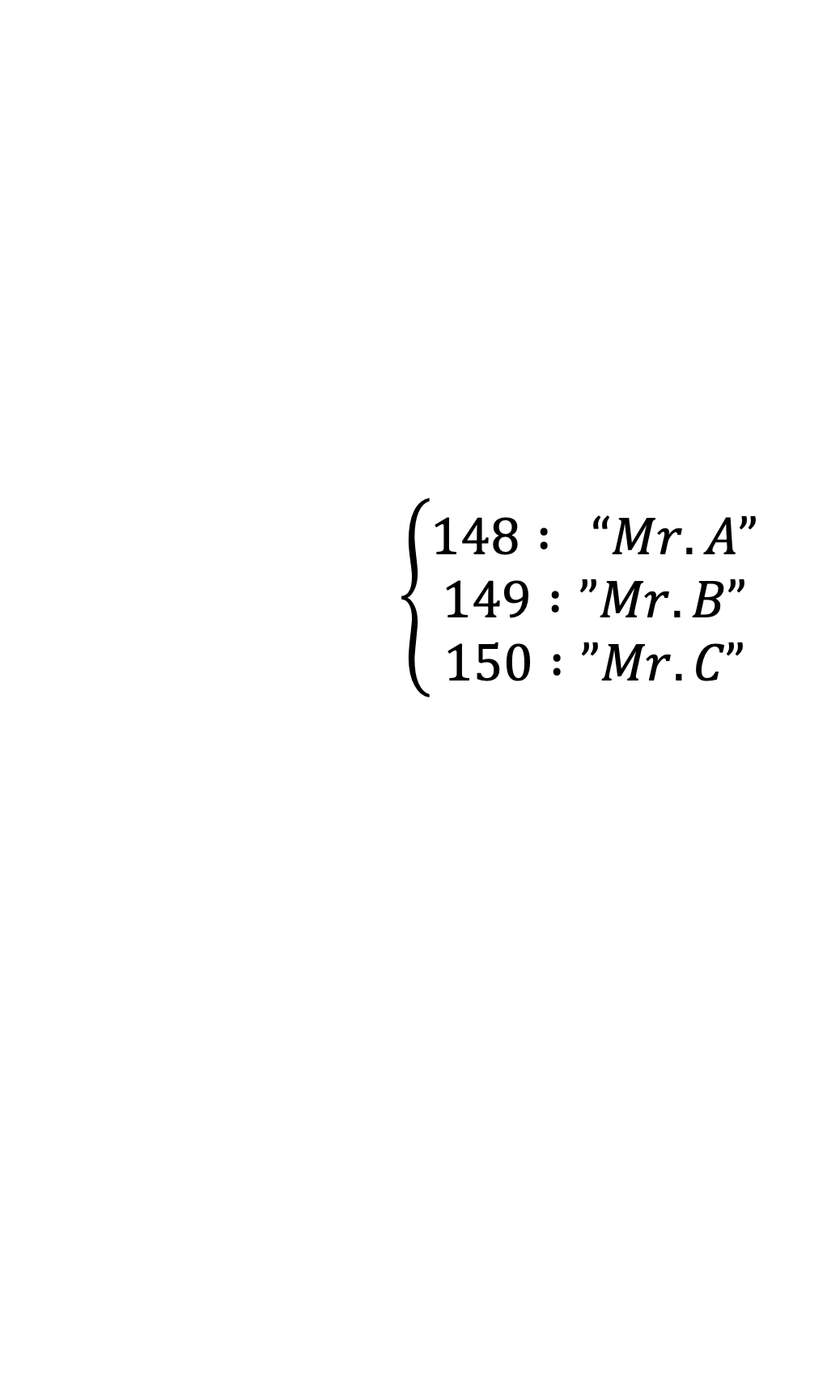
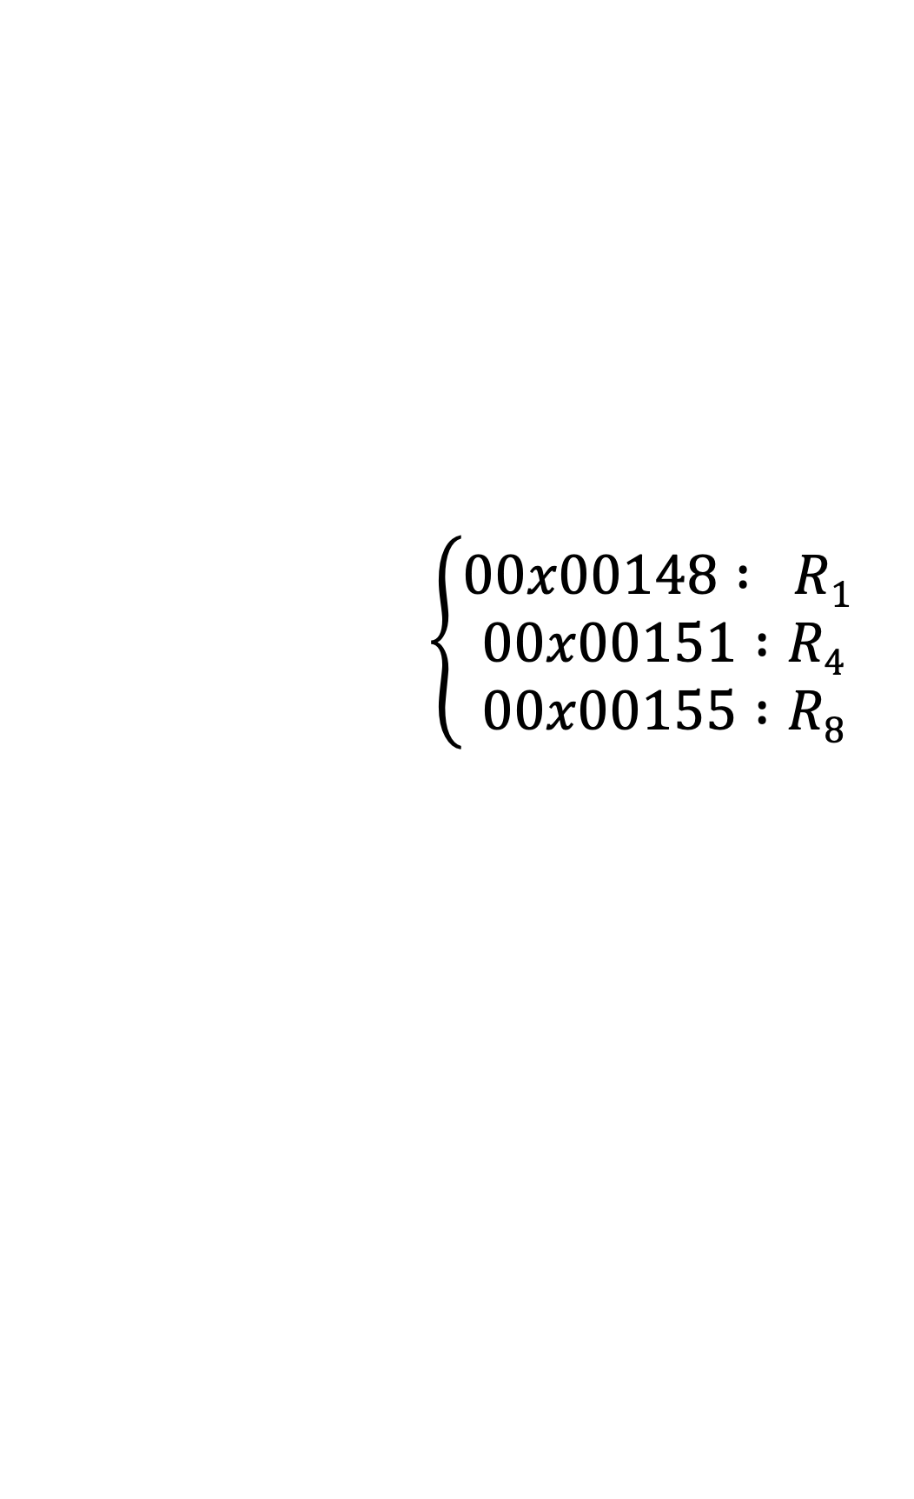
Map-Reduce
Partitioner is like a hashing here.
It accepts key-value and apply hashing logic
Decide which ”ID” will be assigned to the task.
How this is decide, which output will assign to which reducer?
Partitioner will help in deciding this.
$$\left\{\begin{aligned}00x00148 : R1 \\ 00x00151 :R4 \\ 00x00155 :R8\end{aligned}\right.$$
Record 1
$$\left\{\begin{aligned}148 : “Mr. A” \\ 149 :”Mr. B” \\ 150 :”Mr.C”\end{aligned}\right.$$
Record 2
Record 3
Raw data

Slide 14

Map-Reduce
$$\left\{148 : “Mr. A”\right\}$$
Id = 0
Partitioner
Record 1
Id = 1
Hash logic
Hash (key) = key % total number of reducers
E.g., key = 148 then 148 % 2 = 0 → Record I will be processed on R1
Record II will be processed on ___
R2

Slide 15
Map-Reduce
It arranges the data for each key on an individual reducer.
Before assigning job to the reducer, records are collected and arranged together.
Same key related data may be present on multiple mapper tasks.
It is required to be together for better performance.

Slide 16
Map-Reduce
It receives the data from the mapper tasks and generate the resulting output.

Slide 17
Map-Reduce
Reducers’ output needs the reverse process.
Write the data in the desirable format in HDFS.

Slide 18
Map-Reduce
Generate the reference for the output data.

Slide 19
Map-Reduce
Word count example in map-reduce.
Count the frequency of each word written in the input_file.txt.

Slide 20
Map-Reduce

Slide 21
End of Hadoop

